Slide 1
Network Layer

Slide 2
Network Layer Services
Logical Addressing:
  Two computer in communicate should have universal identification system called logical address.
Services provided at the Source Computer:
  Packetizing.
    Encapsulate data coming from upper layer in a datagram.
  Finding the logical address of the next hope.
    Datagram contains the source and destination addresses of the packet.
    Datagram have to pass through many networks to reach its final destination.
    If the destination computer is not connected to the same network as the source, the datagram should be delivered to the next router.
    The source and destination address in the datagram does not tell anything about the logical address of the next hop.
    The network layer at the source computer needs to consult a routing table to find the logical address of the next hop.

Slide 3
Network Layer Services
  Finding the physical (MAC) address of the next hope.
    The network layer does not actually deliver the datagram to the next hop; it is the duty of the data link layer to do the delivery.
    The data link layer needs the MAC address of the next hop to do the delivery.
    To find the MAC address of the next hop, the network layer could use another table to map the next-hop logical address to the MAC address.
    Address Resolution Protocol (ARP) that finds the MAC address of the next hop given the logical address.
  Fragmentation.
    Most LANs and WANs have a limit on the size of the data to be carried in a frame (MTU).
    The datagram prepared at the network layer, may be larger than that limit.
    The datagram needs to be fragmented to smaller units before being passed to the data link layer.
    Fragmentation needs to preserve the information at the header of the datagram.

Slide 4
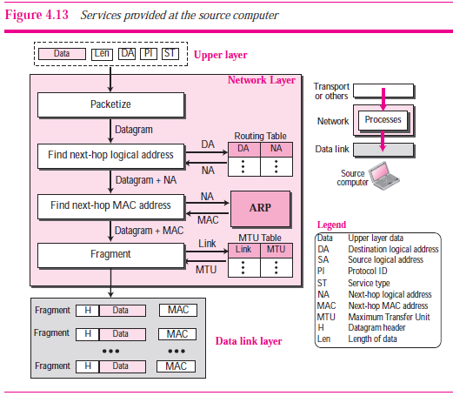

Slide 5
Network Layer Services
Services provided at each Router:
  Router is involved with two interfaces with respect to a single datagram: the incoming interface and the outgoing interface.
  The network layer at the router, therefore, needs to interact with two data link layers: data link layer of incoming interface and outgoing interface.
  The three processes (finding next-hop logical address, finding next-hop MAC address, and fragmentation) here are the same as the last three processes mentioned for a source.
  Before applying these processes, however, the router needs to check the validity of the datagram using the checksum.
  Validation here means that the datagram header is not corrupted and the datagram is delivered to the correct router.

Slide 6
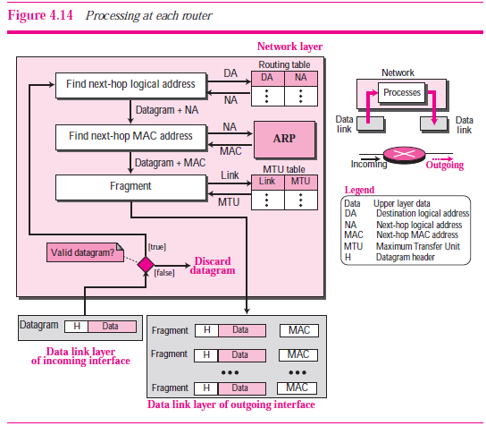

Slide 7
Network Layer Services
Services provided at Destination Computer:
  Destination computer needs to assemble the fragments before delivering the data to the destination.
  After validating each datagram, the data is extracted from each fragment and stored.
  When all fragments have arrived, the data are reassembled and delivered to the upper layer.
  The network layer also sets a reassembly timer.
  If the timer is expired, all data fragments are destroyed and an error message is sent that all the fragmented datagram need to be resent.
  The process of fragmentation is transparent to the upper layer because the network layer does not deliver any piece of data to the upper layer until all pieces have arrived and assembled.
  Reassembly procedure is very delicate and complicated.

Slide 8
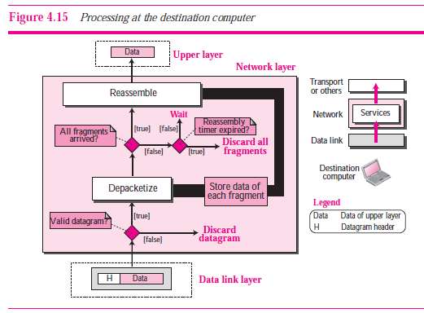

Slide 9
Network Layer Issues
Error Control:
  Mechanism for detecting corrupted, lost, or duplicate datagram.
  Mechanism for correcting errors after detection.
  Network layer does not provide error control mechanism.
  ICMP is used by Internet , that provide some kind of error control if the datagram is discarded.
Flow Control:
  Network layer does not provide flow control mechanism.
Congestion Control:
  Congestion in the network layer is a situation in which too many datagrams are present in an area of the Internet.
  Congestion may occur if the number of datagrams sent by source computers are beyond the capacity of the network or routers.
  Congestion Control in a Connectionless Network
  Congestion Control in a Connection-Oriented Network
Error Control:
Flow Control
Congestion Control
Quality of Service
Routing
Security

